Slide 1
Preparing for Budget Development
GO Team Meeting #4

Slide 2
Agenda
Fall ACES Presentation
Review of Strategic Plan and priorities progress
Preparing for the Budget Development
Rank Strategic Priorities

Slide 3
Accountability
Collaboration
Equity
Support
Fall 2022 ACES Presentation

Slide 4
8 years
5
15 years
1 (1:1 para)
International Baccalaureate
In Progress
X
Fall 2024/Spring 2025
Teaching & Learning: Curriculum Implementation
Teaching & Learning: Professional Learning
N/A (<10 students)
269
46 students
296
N/A (<10 students)
- 36

Slide 5
Indicator | Time Frame
 | September 2021 | September 2022
Attendance Take Rate | 94.4% | 98.3%
ADA Attendance Rate | 86.0% | 93.4%
Students not chronically absent | 53% | 78.6%
0.29
Subgroup | Total number of students | OSS Suspension Rate
Female | 130 | 0
Male | 129 | .60
SWD | 45 | .12
Black | 239 | 0.25
Hispanic | N/A | N/A
Multi-race | N/A | N/A
White | 11 | 1.55
Asian | N/A | N/A
*As of 09/27/2022
*As of 09/28/2022
Notes:
ACES 2.0 School culture
Restorative practices
Family engagement

Slide 7
Program | Avg. Daily Use (Mins) |  | Avg. Weekly Use (Days)
 | Spring 2022* | Fall 2022** | Spring 2022 | Fall 2022
System 44 | 18.4 minutes | 19.4 minutes | 2.1 days | 1.7 days
iRead | 23.2 minutes | 22.8 minutes | 1.8 days | 1.5 days
*Spring 2022: As of April 30, 2022
**Fall 2022: As of September 16th, 2022

Slide 8
 | CIP Strategy | Action Step Progress Update
ELA | We will use the Accountable, Consistent, Evaluations (ACE) strategy to increase school-wide implementation of phonics and literacy curriculum. | Action Step #1: Teachers will participate in bi-weekly planning sessions to review upcoming lessons and model effective practices. We have implemented weekly planning sessions. In response to classroom observations and feedback, we have adjusted student and teacher support to reflect high-needs areas.
Math | Provide professional learning opportunities related to content and differentiation of learning. | Action Step #1: Bi-monthly math PD on content We have focused on ensuring teachers have a strong understanding of our math framework and the student/teacher observables under each component.
Whole Child & Student Support | We will build a stronger connection between school and home with our parents to decrease the percentage of chronically absent students by 5%. | Action Step #1: Parents receive daily phone calls and home visits (as needed) regarding absences and tardies. We have set up a daily robocall that goes out to parents. We also have our Attendance Specialist make personal phone calls daily to all students that are marked absent.
Family Engagement | We will increase the number of parents participating in our Academic Parent Teacher Teams APTT (K-3) program by 5% from the previous year. | Action Step #2: Outline a Year at a Glance Schedule for Implementation We have mapped out our dates for the year. We are excited to implement our first event during Literacy Night later this month.

Slide 9
Additional content specialists, for both reading and math, that can assist in providing consistent weekly instructional support to our grade level teams.

Slide 11
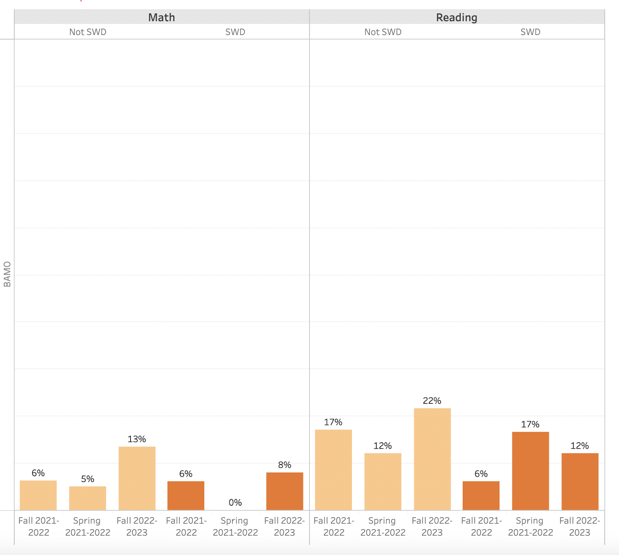

Slide 12
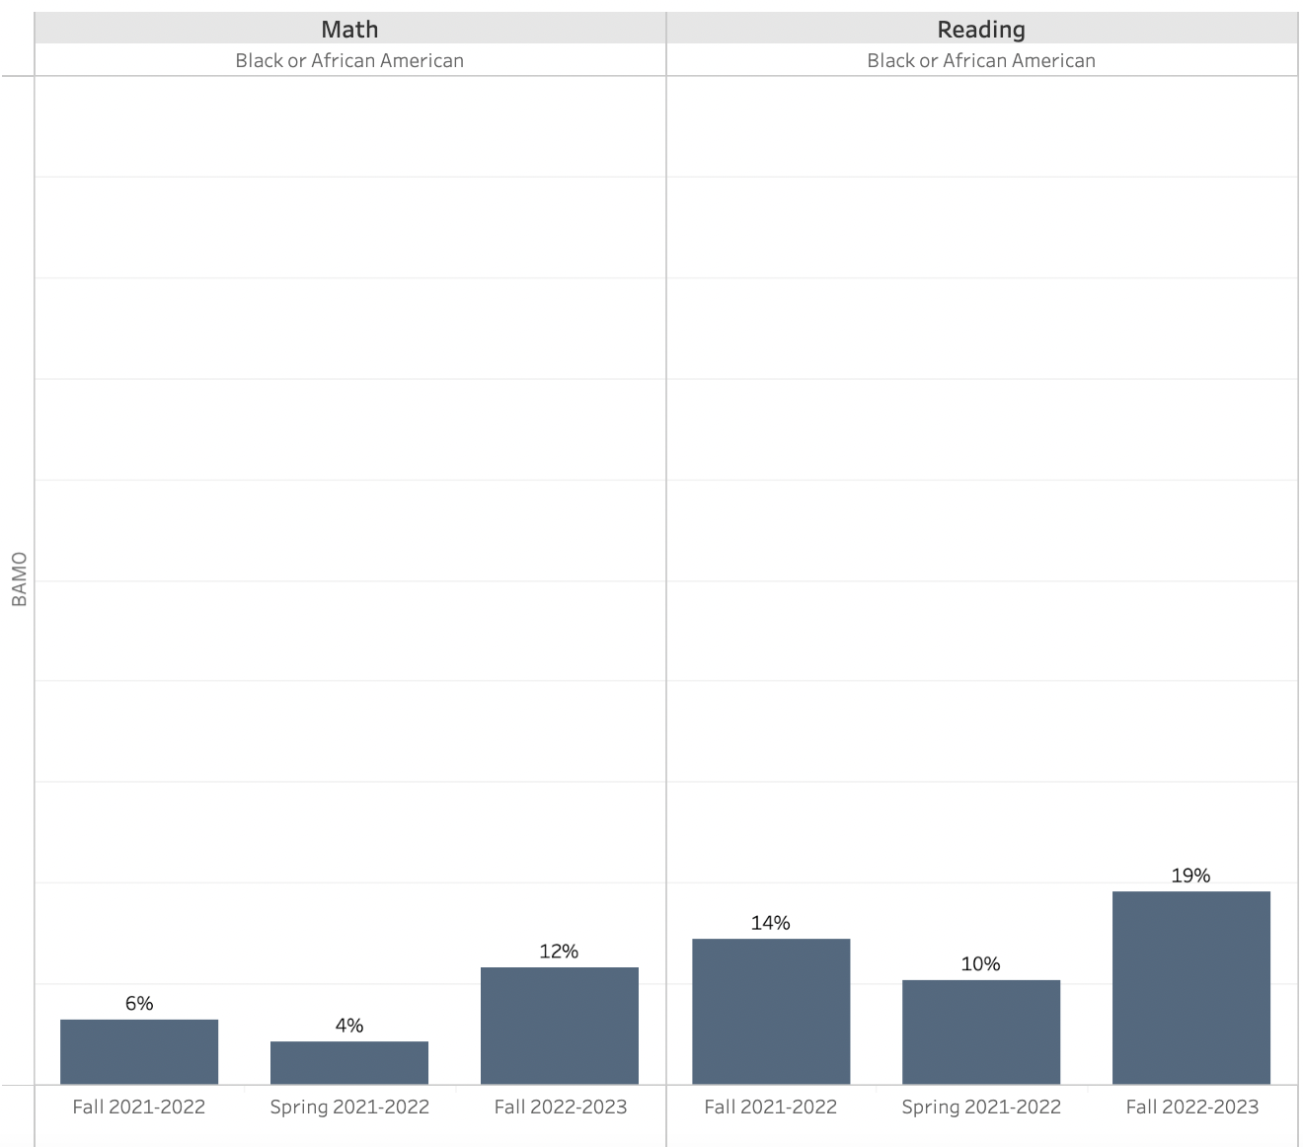

Slide 13
Strategic Plan Progress

Slide 14
Mission: Our mission is to enrich, nurture, and respect all children as unique individuals while fostering an environment which develops the social, emotional, physical, and intellectual development of every child.
Barack and Michelle Obama Academy
Vision: To work collaboratively as school leaders, teachers, parents, and community members, to provide a child-centered learning environment focused on high student achievement for all students.
SMART Goals
Literacy
By March 2023, students scoring at the beginning level on MAP will decrease from 47% to 44%. ​
​
By March 2023, students scoring at the proficient level and above on MAP will increase from 20% to 25% .
Mathematics
By March 2023, students scoring at the beginning level on MAP will decrease from 45% to 42%. ​
​
By March 2023, students scoring at the proficient level and above on MAP will increase from 13% to 18%.
Attendance
Decrease the percentage of students with chronic attendance concerns from 49.6% to 44%.​
APS Strategic Priorities & Initiatives
School Strategic Priorities
School Strategies
1A. Utilize the Fountas and Pinnell curriculum with fidelity in order to implement a Balanced Literacy Framework (guided reading, mini-lesson, interactive read aloud, and small group instruction) in K-5 classrooms . (Literacy)
1B. Implement FUNdations phonics program across K-2 classrooms. (Literacy)
1C. Implement a conceptual math framework using the Georgia Standards of Excellence and Eureka.
1D: Provide remediation and acceleration as indicated by MAP Growth Reading/Math (K-5) & Reading Fluency (PreK-2) Assessment Data.
2A. Complete the IB feasibility study and apply for candidacy.
2B. Implement a Performing Arts Pathway.
Fostering Academic Excellence for All
Data
Curriculum & Instruction
Signature Program
1. Improve student mastery of core content knowledge in literacy and mathematics.
2. Prepare all students to have a global mindset inclusive of the learning profiles, learner attributes, and self-inquiry.
Building a Culture of Student Support
Whole Child & Intervention
Personalized Learning
3. Utilize various interventions to support closing our current academic gaps.
4. Build systems identifying and addressing root causes to promote social-emotional growth.
3A: Utilize Reading Specialist to implement small group instruction to support lowest 25% of student population.
3B: Implement a 30-minute intervention/enrichment block four days a week to provide individualized instruction using iRead, Read 180, System 44, Do The Math, and Enrichment Platforms.
4A: Implement a PBIS school-wide behavior plan with IB/SEL alignment.
4B: Implementation of a school based sensory room for students to help support opportunities for Restorative Practices.
Equipping & Empowering Leaders & Staff
Strategic Staff Support
Equitable Resource Allocation
5. Build teacher capacity in core content areas, literacy and mathematics.
6. Build teacher capacity in the understanding of IB/SEL Competencies.
5A. Professional learning around Balanced Literacy framework (guided reading, mini-lesson, interactive read aloud, and small group instruction).
5B. Professional learning around FUNdations phonics program (K-2 teachers).
5C. Professional learning to improve teacher understanding of the Georgia Standards and Eureka program.
5D. Professional learning to increase teacher understanding of the implementation of the C-R-A model, with the use of manipulatives, to build students’ conceptual understanding of content.
6A. Monthly 90-minute professional learning around the IB competencies.
Creating a System of School Support
Collective Action, Engagement & Empowerment
7. Inform, engage, and activate the community.
7A: Provide resources for parents in order to assist them in helping their students through APTT (Academic Parent-Teacher Teams K-2).
7B: Use of full-time parent liaison to build relationships with parents and provide opportunities to collaborate.
7C: Use of multiple communication channels to reach all stakeholders (Wednesday Courier, Robo Call, Remind 101, School Marquee, Twitter, Instagram, School Website)
7D: Build community connection and collaboration through outreach and partnerships.

Slide 15
Action on the Updated Strategic Plan
The GO Team needs to TAKE ACTION (vote) on its updated Strategic Plan. After the motion and a second, the GO Team may have additional discussion. Once discussion is concluded, the GO Team will vote.

Slide 16
Preparing for Budget Development

Slide 17
Discussion
Strategic Plan Priority Ranking
In preparation for the 2023-2024 Budget Development (January–March 2023), the GO Team needs to rank its Strategic Plan Priorities. Use the next slide to capture the priority ranking.

Slide 18
Strategic Plan
Priority Ranking
Insert the school’s priorities from Higher to Lower
Higher
Improve student mastery of core content knowledge in literacy and mathematics. (#1)
Build teacher capacity in core content areas, literacy and mathematics. (#5)
Utilize various interventions to support closing our current academic gaps. (#3)
Build teacher capacity in the understanding of IB/SEL competencies. (#6)
Prepare all students to have a global mindset inclusive of the learning profiles, learner attributes, and self-inquiry. (#2)
Inform, engage, and activate the community. (#7)
Build systems identifying and addressing root causes to promote social-emotional growth. (#4)
Lower

Slide 19
Action on the Strategic Plan Priorities
The GO Team needs to TAKE ACTION (vote) on its ranked Strategic Plan Priorities. After the motion and a second, the GO Team may have additional discussion. Once discussion is concluded, the GO Team will vote.

Slide 20
Where we’re going
At our next meeting we will begin the discussion of the 2023-2024 budget.
Let me or the Chair know of any additional information you need for our future discussion.

Slide 21
Thank you

